Slide 1
Intro to AI and ML

Slide 2
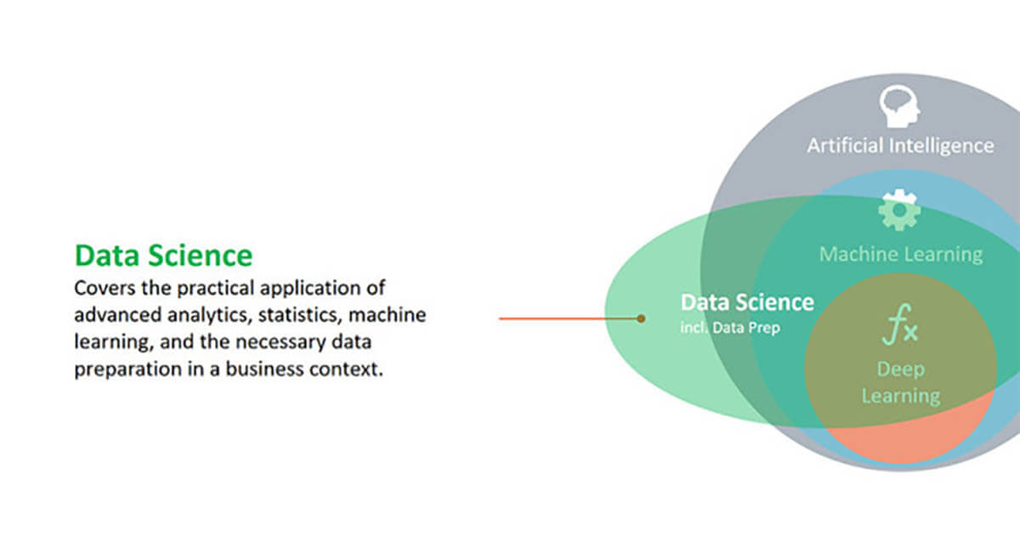

Slide 3
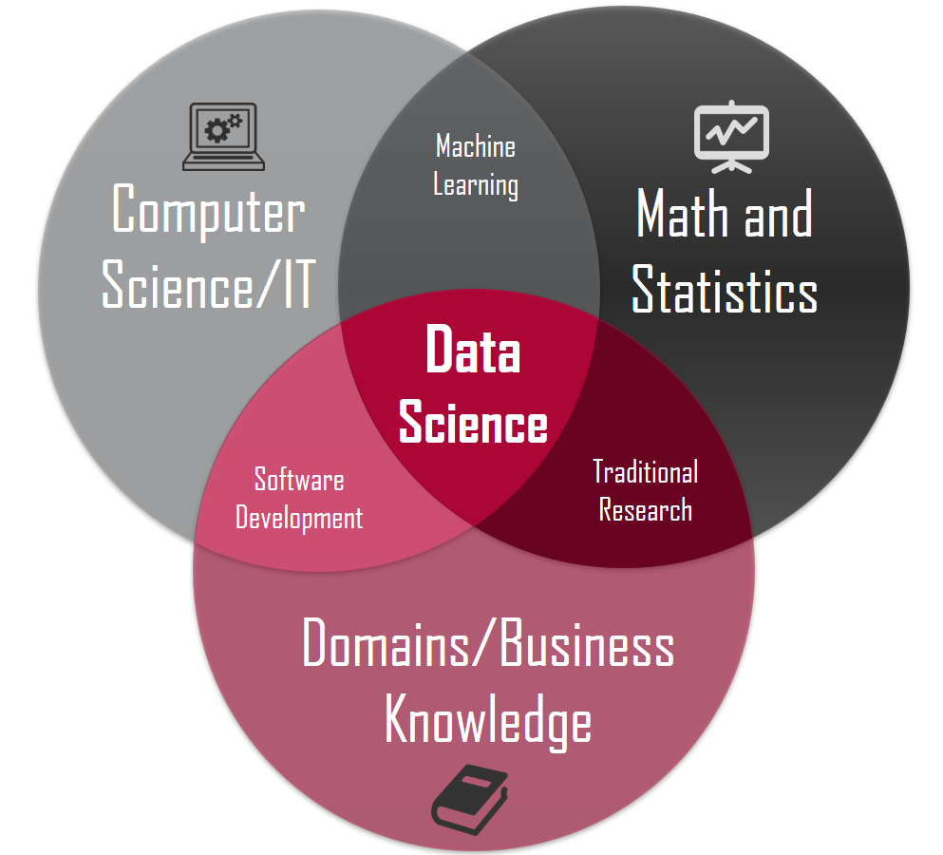

Slide 4
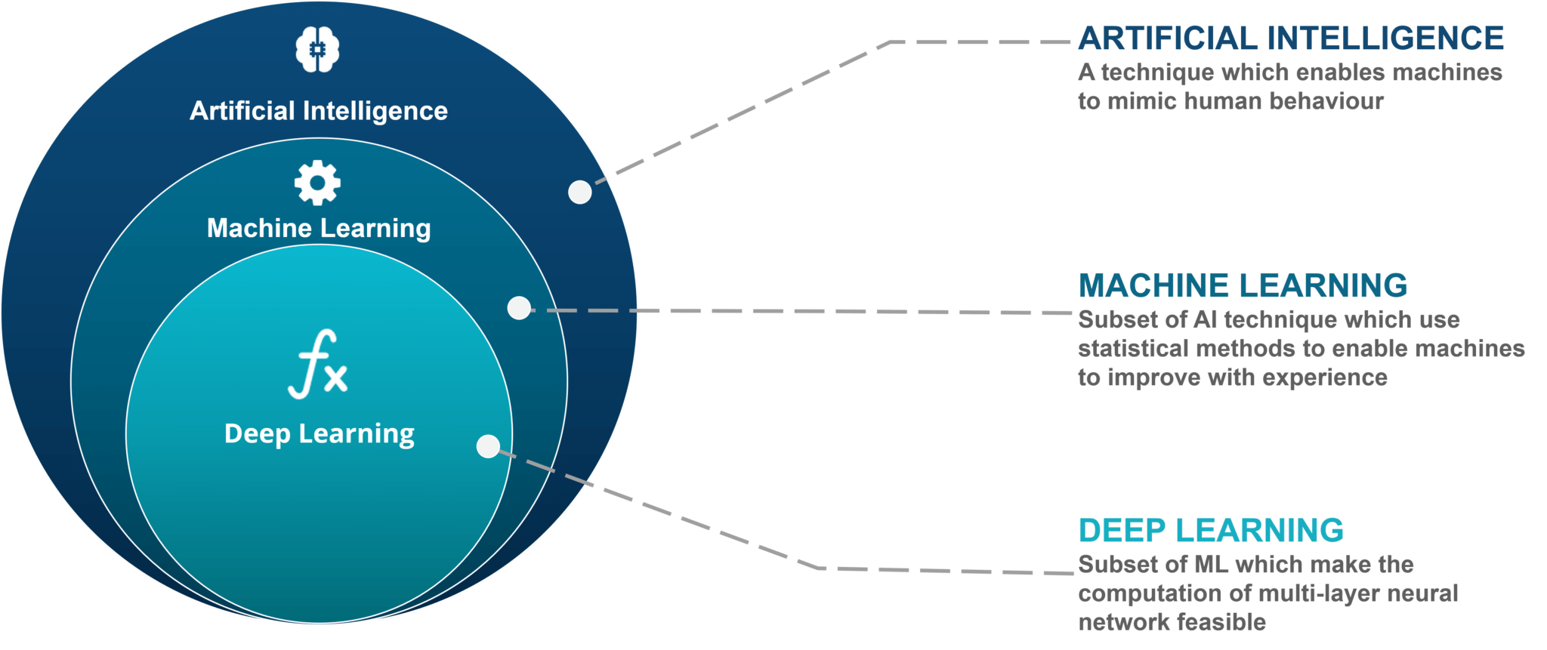

Slide 5
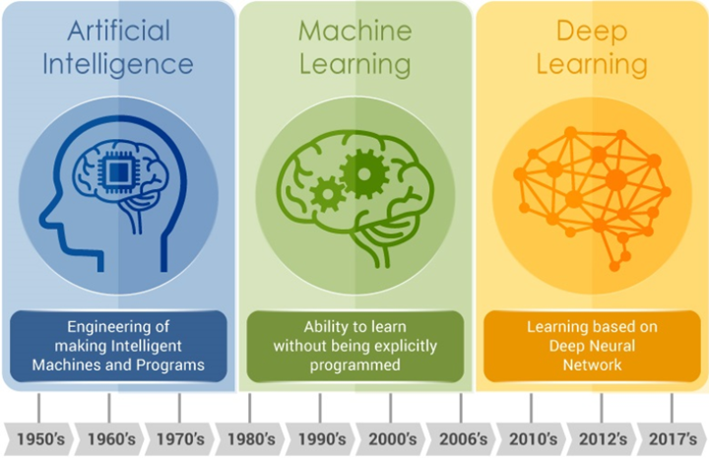

Slide 6
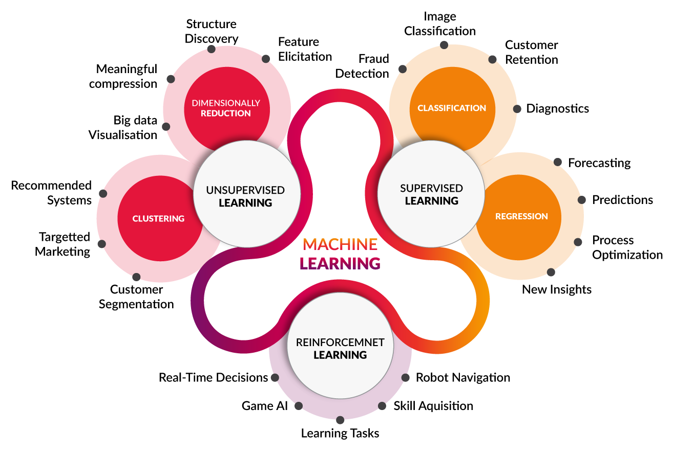

Slide 7
Sources:
https://www.geeksforgeeks.org/introduction-deep-learning/
https://www.geeksforgeeks.org/artificial-intelligence-vs-machine-learning-vs-deep-learning/
https://www.edureka.co/blog/what-is-machine-learning/
https://www.youtube.com/watch?v=QizsAE4fBpQ (AI vs Data Science)

